Slide 1
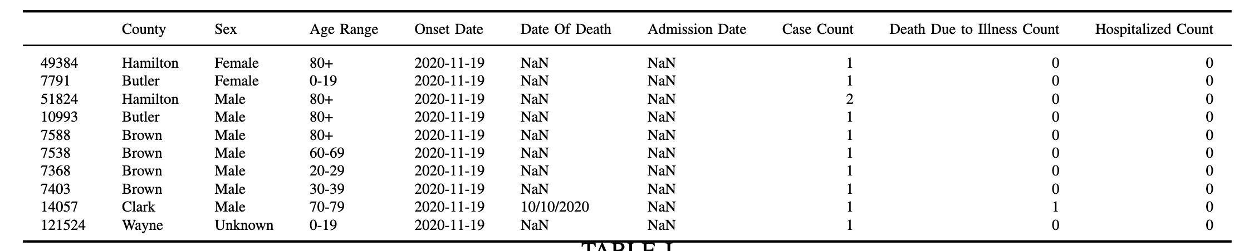
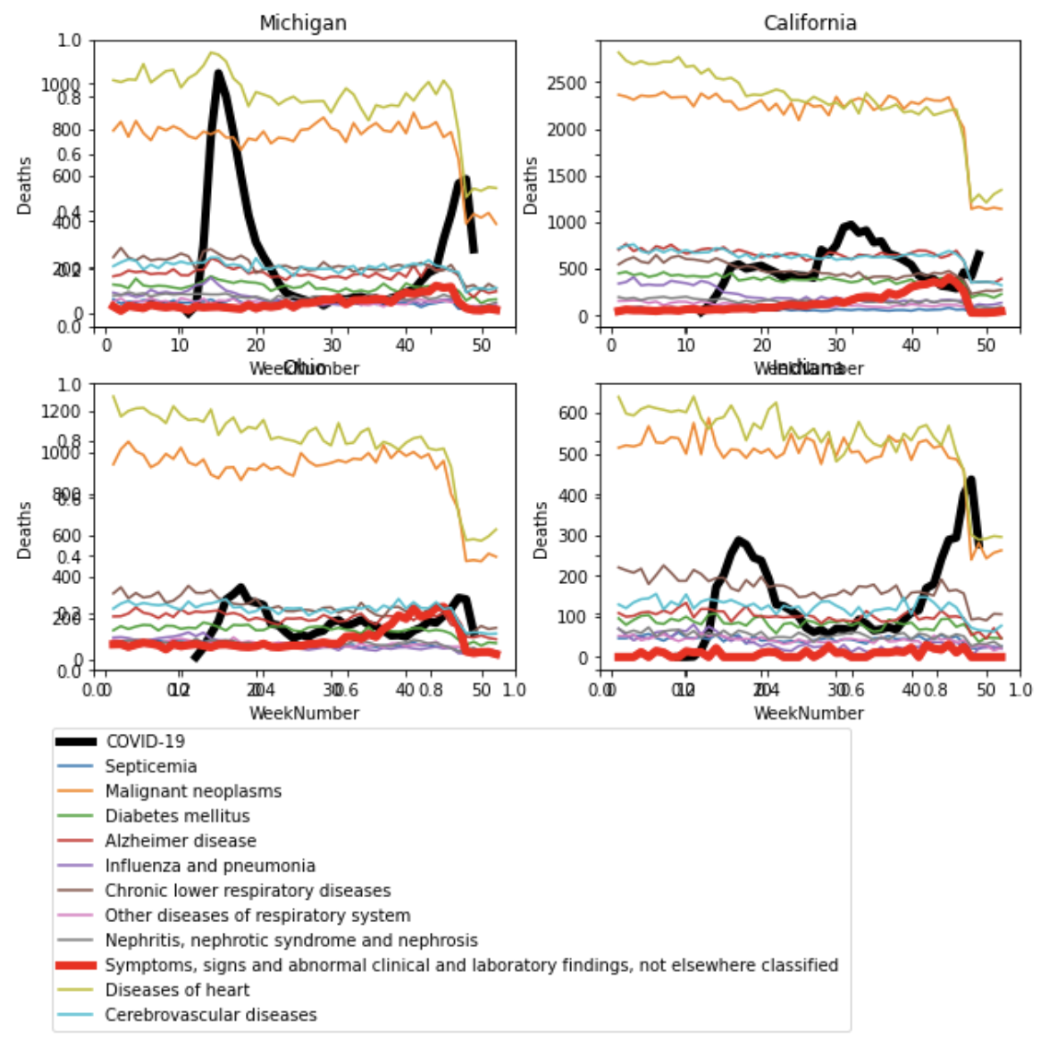
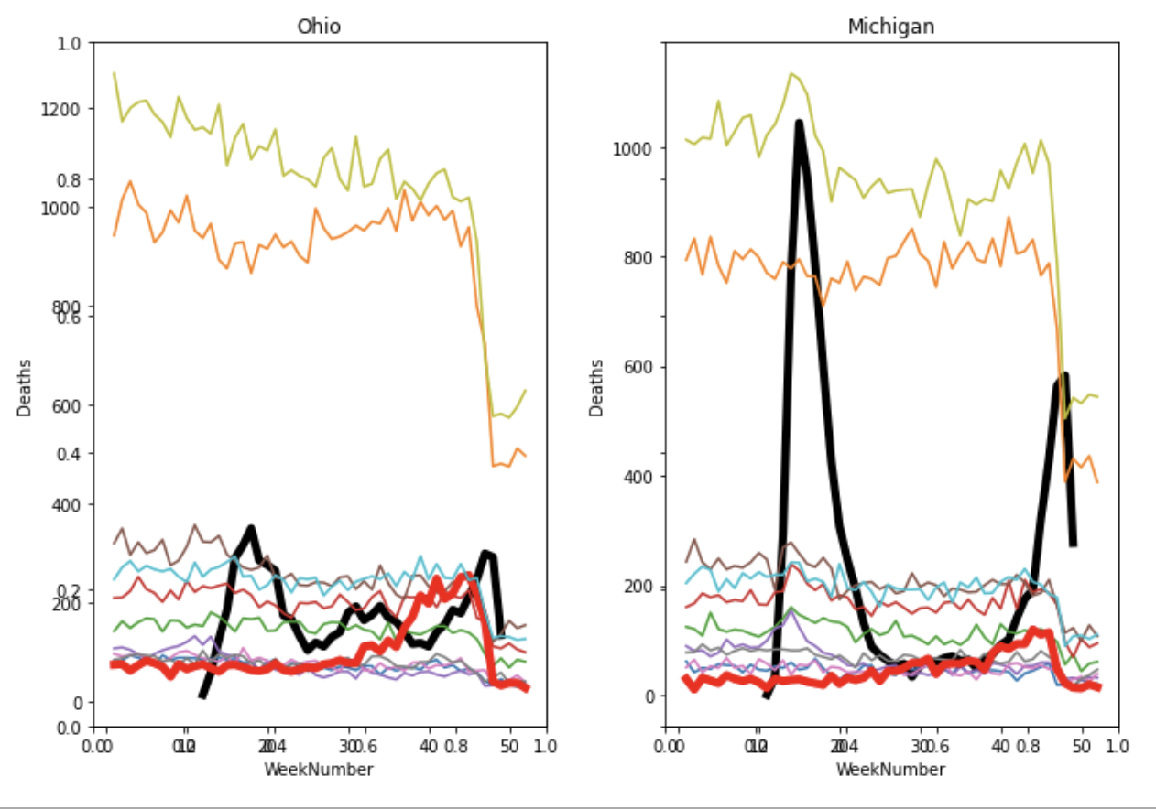


COVID-19: Deaths Statistical Analysis Standardized process for comparing COVID-19 data for states, and other causes of death.
Non-Cognitive Predictors of Student Success: A Predictive Validity Comparison Between Domestic and International Students
Non-Cognitive Predictors of Student Success: A Predictive Validity Comparison Between Domestic and International Students
COVID-19: Deaths Statistical Analysis
AMMO BAR
More detailed results:
Raw data (Ohio)
Comparison with The COVID Tracking Proj.:
Weekly death comparison:
Alexey Luchinsky, Mike Terry, Vagish Vela
INTRO
Coronavirus Disease 2019 (COVID-19) was a global pandemic as of March 2020, COVID-19 is a major issue in 2020 with wide ranging global impact for the economy, mental and physical health. Our aim is to see if we can find trends between states for COVID-19 as well as compare it against other causes of death.
METHODS
COVID-19 data is downloaded from state departments
Raw data processed into a standardized format, replicable for all states
Compared with processed by The COVID Tracking Project by state
Compared against CDC Yearly and Weekly death date by state
RESULTS
The US states data we tested (California, Indiana, Michigan, Ohio) closely align to the data aggregated by The COVID Tracking Project
On an annual level COVID-19 is 6th biggest killer
On a weekly level, COVID-19 ranges from mostly being the 3rd biggest to most deadly cause
DISCUSSION
What do the abnormal symptoms mean?
Take a picture to download the text
Notes:
Notes:
In Powerpoint, click View > Guides
Keep text within gutter guides.
Author list: Don’t split names onto two lines (e.g., “Jimmy [break] Smith”). If that happens, use a new line, unless you need the space. Bold the first names of anybody who’s presenting in person.
Intro/methods/result: Do not drop below font size 28, but if you have extra space, jack up the font size until the space is full.
Do not use color in the sidebars except in graphs/figures. It’ll pull attention from the center and slow interpretation for passersby.

